Slide 1





Introduction to Robotic Process Automation
ECOMMERCE CUSTOMER REVIEWS ANALYSIS BOT
Register No.: 220701084
Name : HARINI A
Guide name & Designation:
Mrs. Jinu Sophia
Assistant Professor (SG)

Slide 2
Abstract
This project leverages Robotic Process Automation (RPA), powered by UiPath, to automate sentiment categorization, addressing the challenge of analyzing large volumes of text data. The system processes input data from various sources, such as CSV files or APIs, and applies Natural Language Processing (NLP) techniques to classify text into three categories: Happy, Sad, and Neutral. The workflow involves preprocessing raw text to ensure uniformity, invoking a sentiment analysis engine for classification, and exporting results into a structured Excel format. The modular architecture integrates seamless automation, efficient error handling, and scalability, making it suitable for diverse applications such as customer feedback analysis and social media monitoring. This solution not only improves accuracy and speed but also reduces manual effort, offering an innovative and reliable tool for sentiment analysis.

Slide 3
Need for the Proposed System
The manual analysis of large text datasets for sentiment classification is a time-consuming, error-prone, and inefficient process, especially in scenarios involving real-time data like customer reviews, social media comments, and survey responses. Businesses and individuals require an automated solution that ensures speed, accuracy, and consistency in processing textual data. The proposed system, powered by UiPath and Natural Language Processing (NLP), addresses these challenges by automating the sentiment categorization process. This system eliminates manual effort, reduces the likelihood of errors, and delivers results quickly, enabling better decision-making and enhanced productivity. Additionally, its scalability and modular design make it adaptable to various domains, including customer service, market research, and behavioral analysis, providing a versatile and reliable solution for sentiment analysis needs.

Slide 4
Advantages of the Proposed System
Automation: Reduces manual effort by automating the sentiment analysis process.
Accuracy: Ensures consistent and precise categorization of sentiments (Happy, Sad, Neutral).
Efficiency: Processes large datasets quickly, saving time and resources.
Scalability: Can handle increasing volumes of data and adapt to different domains.
Integration Capability: Can integrate with APIs and other data sources for real-time analysis.
Error Handling: Incorporates robust mechanisms to manage errors and ensure smooth execution.
Cost-Effective: Minimizes human intervention, reducing operational costs.
User-Friendly: Provides outputs in an organized format, such as Excel, for easy interpretation.

Slide 5
Literature Survey
Paper 1: Product Sentiment Analysis Using RPA by Shashikant-Singh54
Advantages:
Integration of Deep Learning: Effectively combines RPA with deep learning models for accurate sentiment analysis.
Scalability: Demonstrates scalability for processing large datasets from e-commerce platforms.
Automation Focus: Provides a streamlined workflow for automating sentiment analysis, saving time and effort.
Ease of Use: Implements a user-friendly interface through RPA tools like UiPath, making it accessible for non-programmers.
Clear Data Processing: Incorporates preprocessing techniques like text cleaning and tokenization, enhancing the reliability of the results.
.

Slide 6
Disadvantages:
Dependency on Pre-trained Models: Relies heavily on existing NLP models, limiting customization for specific use cases.
Hardware Requirements: Deep learning integration demands higher computational resources.
Data Source Limitation: Focuses mainly on e-commerce data, reducing its versatility across other domains.
Complex Debugging: Errors in the RPA workflow can be difficult to trace and debug

Slide 7
Paper 2: Product Sentiment Analysis Using RPA by Keeneyetact
Advantages:
Python Integration: Combines RPA with Python for flexible data manipulation and analysis.
Customizable Workflow: Offers modularity, allowing users to adapt the system to various datasets and requirements.
Cost Efficiency: Leverages open-source tools and APIs, minimizing licensing costs.
Focus on Analytics: Emphasizes detailed analytics and reporting for actionable insights.
Use of APIs: Enhances the process through APIs like Google NLP for robust text classification.

Slide 8
Disadvantages:
Less User-Friendly: Requires a basic understanding of Python, which might limit usability for non-technical users.
API Dependency: Reliance on third-party APIs introduces potential issues with availability and cost.
Limited Workflow Optimization: The integration of RPA could be more efficient for smoother automation.
Inconsistent Results: Variations in API results may affect overall sentiment accuracy.

Slide 9
Main Objective
The primary objective of the Sentiment Categorization Project is to develop an efficient and automated system for analyzing and categorizing textual data into three sentiment categories: Happy, Sad, and Neutral. By leveraging UiPath's Robotic Process Automation (RPA) capabilities and integrating Natural Language Processing (NLP) techniques, the project aims to streamline the sentiment analysis process.
This system is designed to:
Eliminate manual efforts and reduce human errors in sentiment analysis.
Enhance accuracy in categorizing text by employing advanced NLP models.
Provide seamless integration with Excel for storing and presenting categorized results.
Enable scalability for large datasets while ensuring user-friendly automation for diverse industries.
This project demonstrates the potential of combining automation and AI to solve real-world problems effectively.

Slide 10
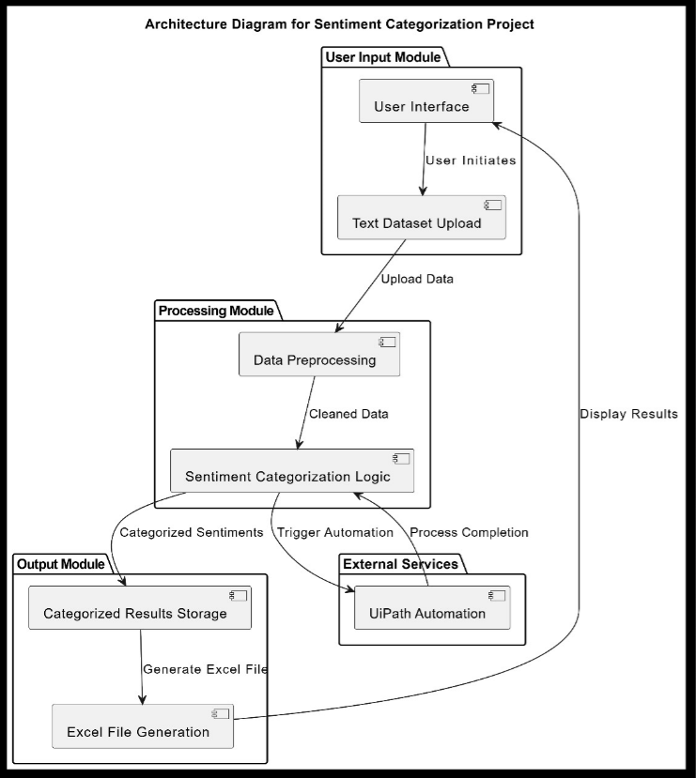
Architecture

Slide 11
System Requirements
Hardware Requirements:
Processor: Intel Core i5 or higher
RAM: Minimum 8 GB (16 GB recommended for better performance)
Storage: At least 50 GB of free disk space
Display: 1080p resolution or higher
Internet Connection: Stable broadband connection for API integration and updates
Input Devices: Standard keyboard and mouse
Software Requirements:
Operating System: Windows 10/11 (64-bit)
Automation Tool: UiPath Studio (latest version)
Programming Frameworks: .NET Framework (if required for dependencies)
Data Processing: Microsoft Excel (for handling data files)
API Services: Integrated sentiment analysis API (e.g., Azure, MonkeyLearn)
Dependencies: Required libraries for CSV/Excel processing and API communication
Browser: Google Chrome/Microsoft Edge for testing and API documentation access

Slide 12
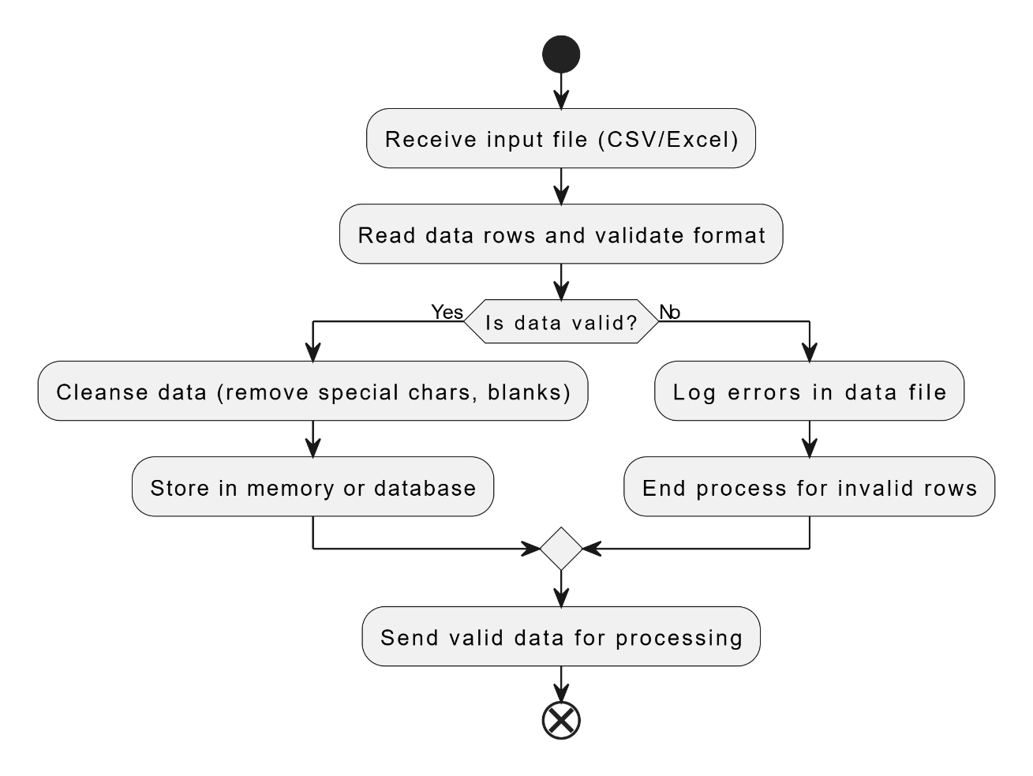
Functional Description
Sentiment Data Extraction
Short Description:
This module focuses on extracting raw data (e.g., text reviews) from an input source such as CSV, Excel files, or APIs. The text data is prepared for sentiment analysis by filtering unnecessary characters and ensuring compatibility with the automation process in UiPath.

Slide 13
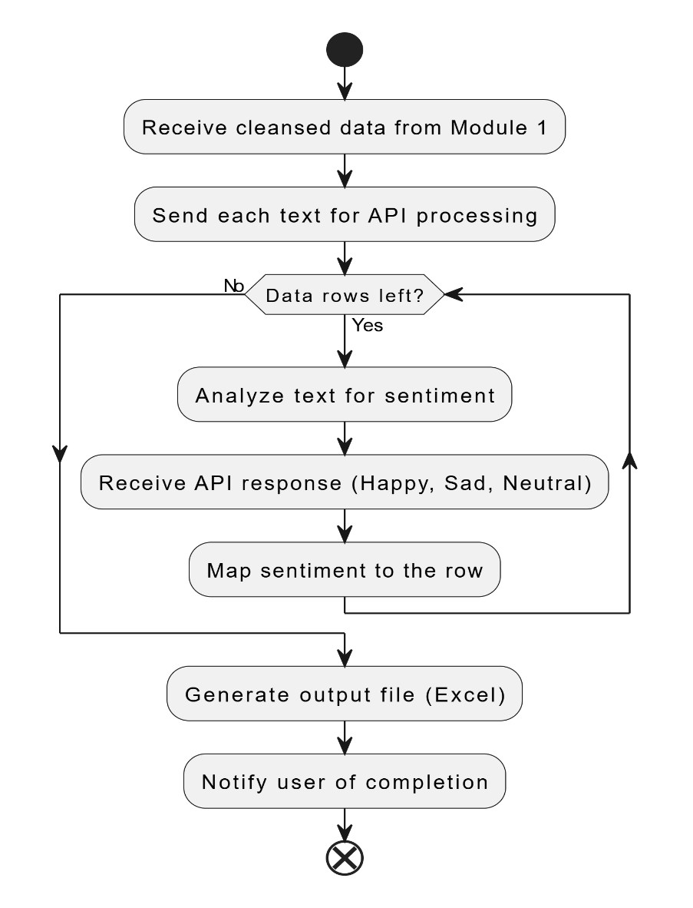
Sentiment Categorization & Output Generation
Short Description:
This module involves processing the cleansed data through a sentiment analysis API and categorizing text into sentiment classes (Happy, Sad, Neutral). The results are then saved in an Excel file, ready for the user to review.

Slide 14
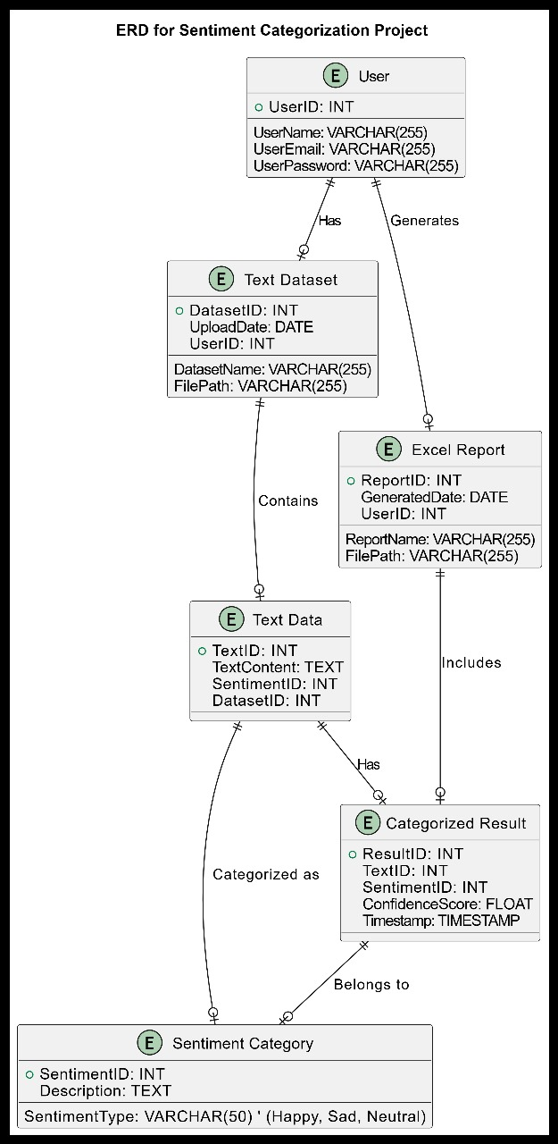

Slide 15
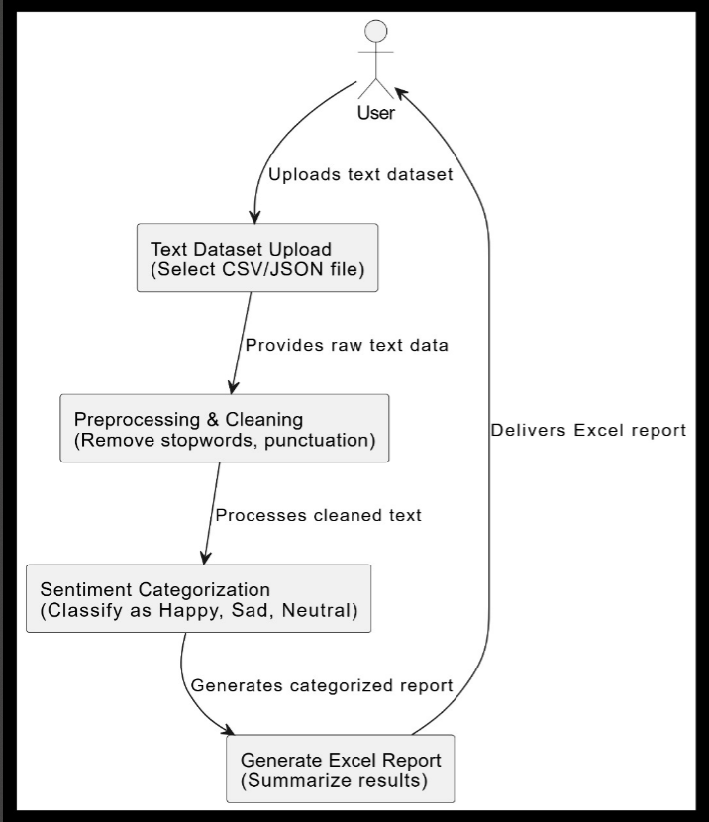
Process Design

Slide 16
Implementation
Implementation of Module 1: Sentiment Data Extraction
Description:
This module handles the preprocessing of input data. It involves reading the source file (CSV/Excel), cleansing unnecessary characters, and validating the data to ensure compatibility with downstream processes.
Example Workflow in UiPath:
Sequence:
Read Input Data.
Filter Invalid Rows.
Cleanse Text Data.
Save Validated Data to File.
Implementation of Module 2: Sentiment Categorization & Output Generation
Description:
This module categorizes the sentiment of each text into Happy, Sad, or Neutral using an API or pre-defined logic. The results are then saved in an Excel file for review.
Example Workflow in UiPath:
Sequence:
Load Cleaned Data.
Send Data for Sentiment Analysis.
Map API Response to Sentiment Labels.
Save Sentiment Output to File.

Slide 17
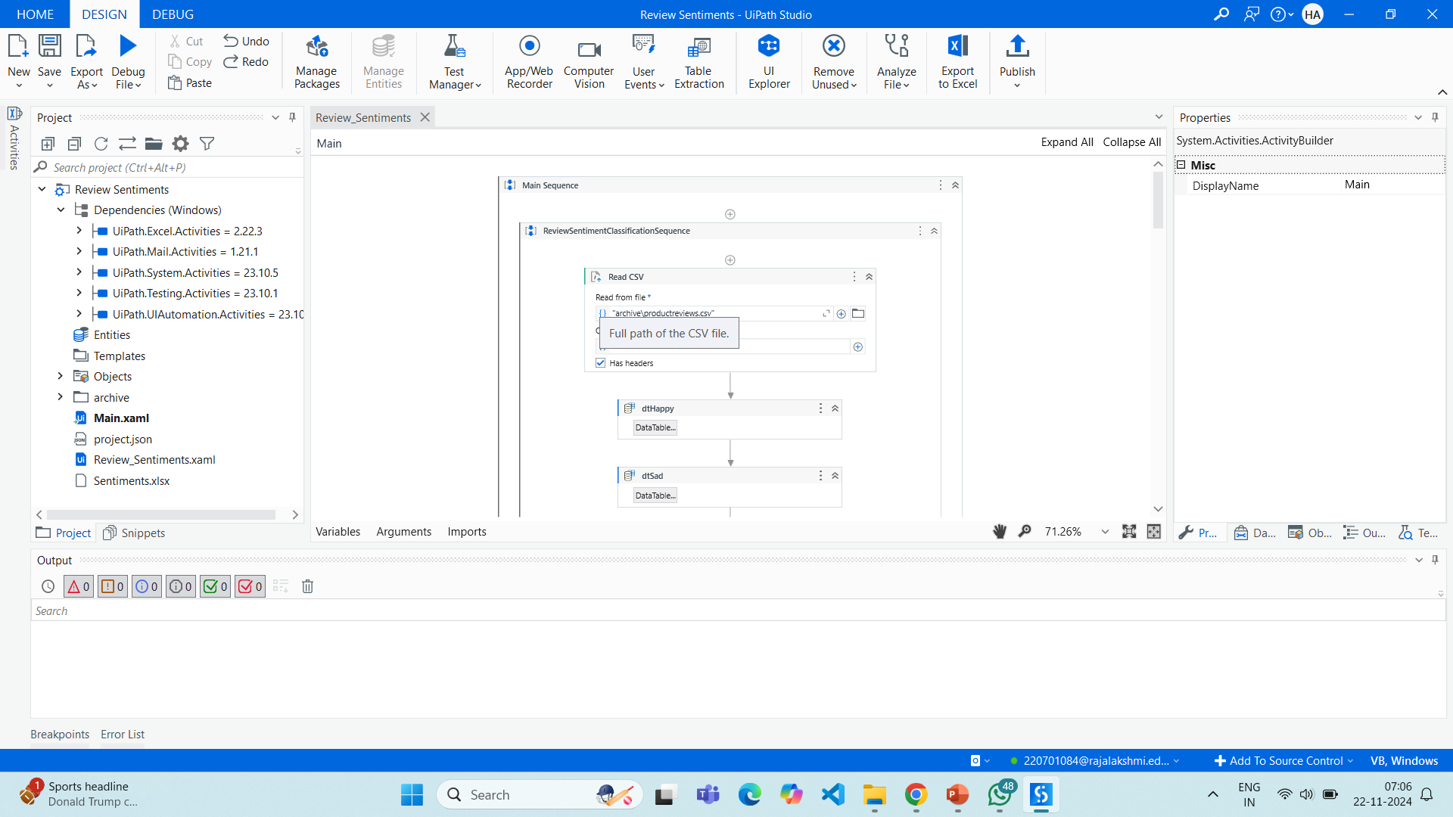

Slide 18
Testing
Testing is a crucial phase in the development lifecycle of the Sentiment Categorization Project, ensuring that all modules function as expected and meet the project objectives. It involves validating the functionality, accuracy, and robustness of the system using test cases and scenarios.

Slide 19
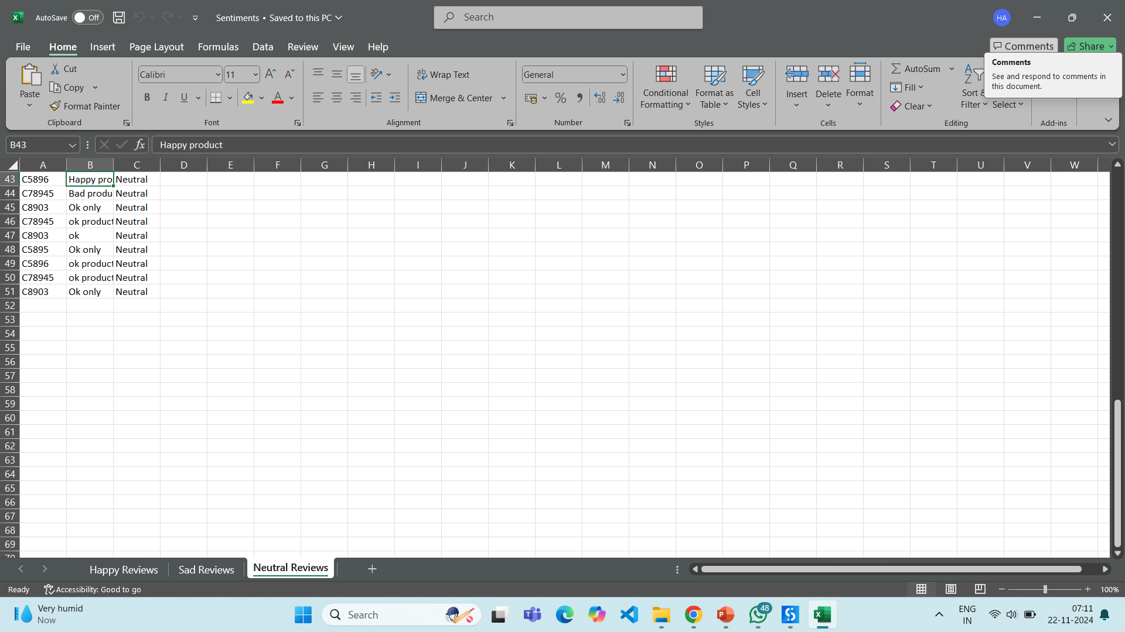
NEUTRAL REVIEWS -SHEET

Slide 20
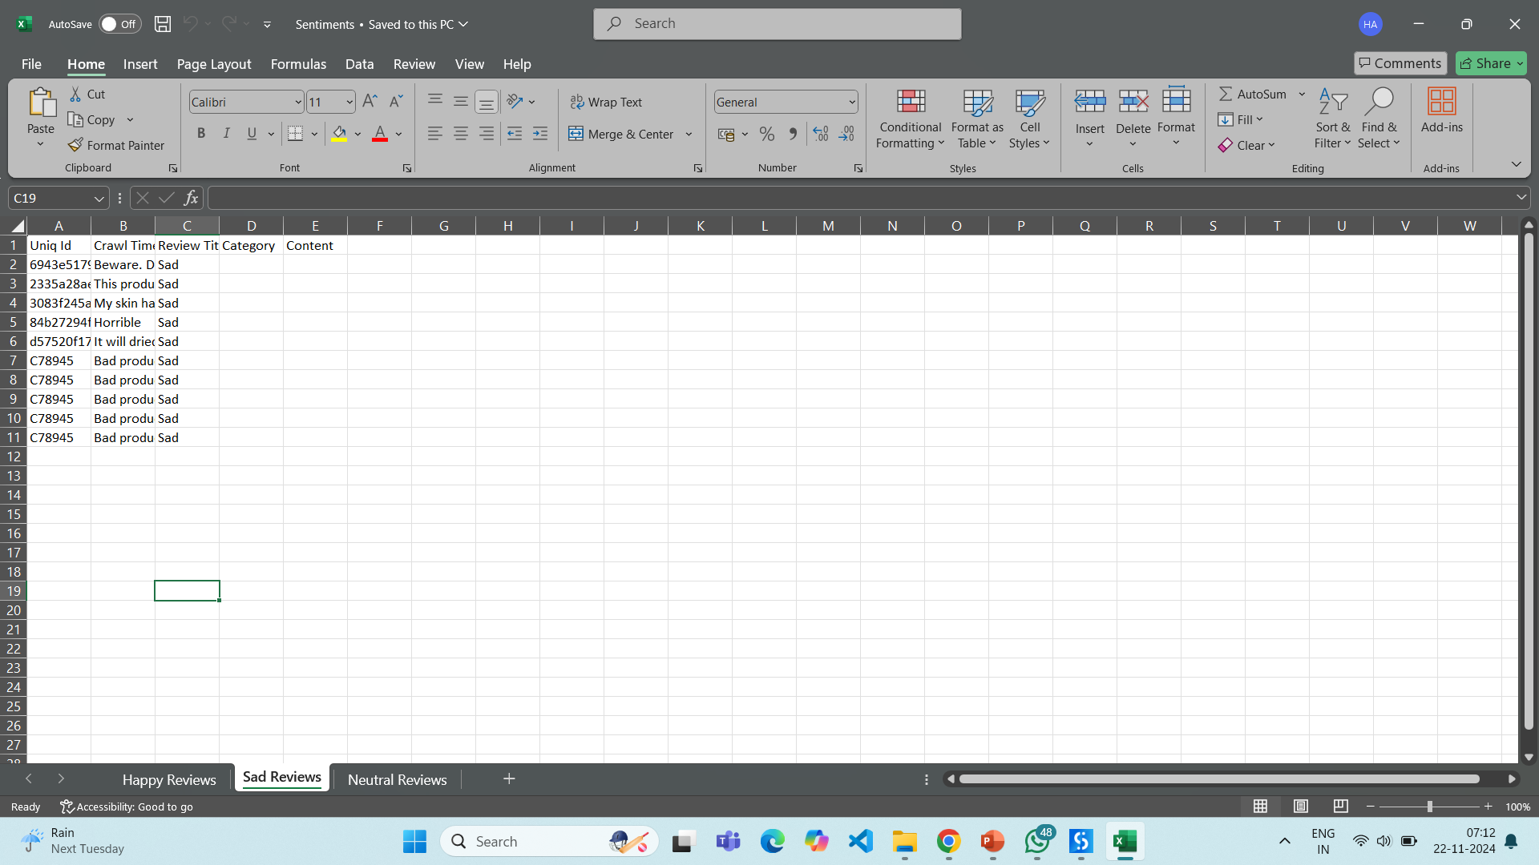
SAD REVIEWS-SHEET

Slide 21
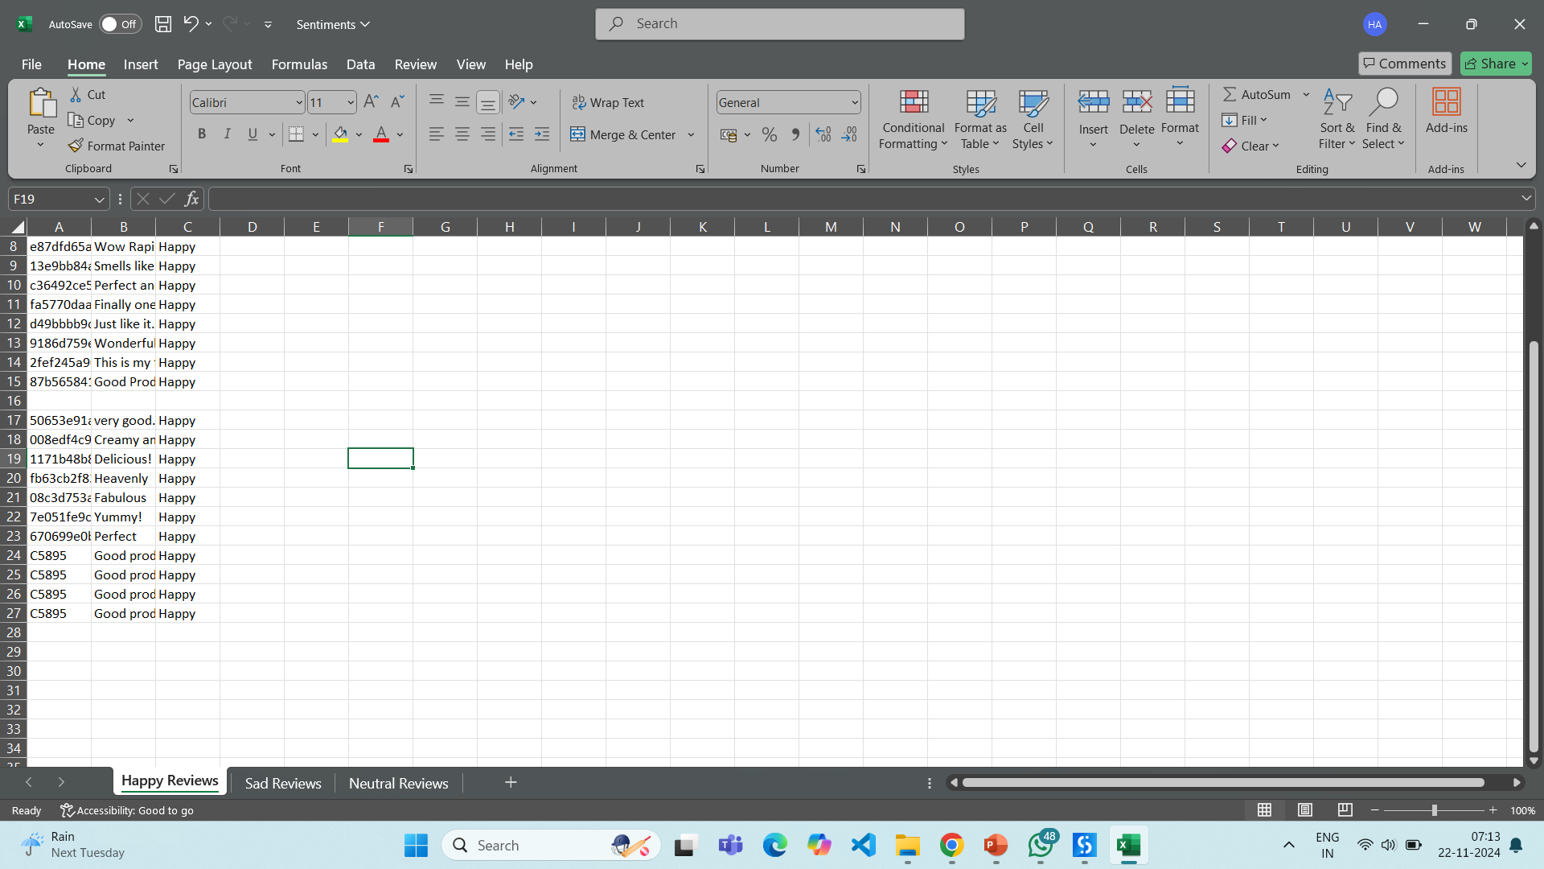
HAPPY REVIEWS-SHEET

Slide 22
Conclusions
The Sentiment Categorization Project successfully demonstrates the automation of sentiment analysis through a robust and efficient framework. By leveraging UiPath's capabilities, the project eliminates the manual effort involved in processing and categorizing text, ensuring accuracy, scalability, and reliability. The system’s ability to classify sentiments into Happy, Sad, and Neutral categories showcases its practical application for businesses and individuals requiring quick sentiment insights from large datasets.
The implementation of a seamless pipeline — from data collection and processing to result generation in Excel — highlights the integration of advanced automation techniques. Through rigorous testing, the project has proven its reliability under various scenarios, validating its use case for real-world applications.
This work not only simplifies the sentiment analysis process but also paves the way for further enhancements, such as integrating advanced machine learning models or extending the sentiment categories. Future work could involve expanding the project's functionality to include multilingual support, providing greater accessibility and usability across diverse industries.

Slide 23
Future Enhancement
Multilingual Support: Expand the system's capability to process and analyze text in multiple languages, broadening its usability across diverse industries and regions.
Integration with AI Models: Incorporate advanced AI and machine learning models for higher accuracy and more nuanced sentiment classification.
Additional Sentiment Categories: Extend the classification beyond Happy, Sad, and Neutral to include categories like anger, surprise, or sarcasm for deeper insights.
Real-Time Sentiment Analysis: Enable real-time processing of live data streams, such as social media feeds or customer feedback forms.
Cloud Deployment: Host the system on cloud platforms to ensure scalability, improved performance, and remote accessibility.
Enhanced Data Visualization: Provide interactive dashboards for visualizing sentiment trends and insights to aid better decision-making.
Mobile Integration: Develop mobile-friendly versions or APIs for seamless integration with apps and on-the-go sentiment analysis.

Slide 24
IEEE Paper
Here are two IEEE papers relevant to your sentiment categorization project:
"Sentiment Analysis of Mobile App Reviews Using Robotic Process Automation"
Description: This paper explores the use of Robotic Process Automation (RPA) to extract and analyze sentiment from mobile app reviews. It demonstrates how automation can enhance efficiency in processing and categorizing user feedback for better decision-making.
Link: Access the paper​IEEE Xplore
.
"Sentiment Analysis Using Machine Learning and Deep Learning Models on Movies Reviews"
Description: This study compares the effectiveness of machine learning and deep learning techniques in performing sentiment analysis on movie reviews, offering insights into the advantages and limitations of various models.
Link: Access the paper

Slide 25
References
Text Sentiment Analysis: A Review" (IEEE)
Description: This paper provides a comprehensive review of sentiment analysis techniques, discussing the advantages, challenges, and diverse applications in real-world scenarios.
URL: Read here​
IEEE Xplore
"A Comprehensive Analysis of Sentiment Analysis: Approaches, Applications, and Classifier Comparisons" (IEEE)
Description: This study explores various sentiment analysis approaches, evaluates their applications, and compares the efficiency of classifiers in sentiment prediction tasks.
URL: Read here​
IEEE Xplore
"Sentiment Analysis Using Machine Learning Techniques" (Springer)
Description: A study on using machine learning models for effective sentiment analysis, focusing on accuracy improvements and model comparison.
URL: Explore here
"Role of NLP in Sentiment Classification and Emotional Intelligence" (ACM)
Description: This paper investigates the integration of NLP tools and techniques for sentiment classification and their impact on understanding emotional intelligence.
URL: Access here
"Applications of Sentiment Analysis in Business and Social Media Analytics" (Elsevier)
Description: Explores the utility of sentiment analysis in business intelligence and social media trends, demonstrating its practical value in decision-making.
URL: Discover here
Journals

Slide 26
Queries

Slide 27
Demonstration

Slide 28
Thank You

